Slide 1

CRYPTOCURRENCY WALLET
Guided by : Submitted by :
Dr.L.Thara
Assistant Professor
Department of Computer Science
PSG College of Arts & Science
Jeevanantham B
19BCM027
jeevabaskaran328@gmail.com

Slide 2
OVERVIEW
The project “JM Crypto wallet” is developed under the platform of windows 10,HTML , CSS , React Js as front end, Express Js as backend, MongoDb as database and Node Js as web server.
In the current generation cryptocurrency plays a vital role.
Only few of them have knowledge about it in India.
To overcome this here I have come with a project named “Cryptocurrency Wallet”.

Slide 3
In “JM Crypto wallet” new user can register and existing user can login.
Users are provided with three options in the main area of window.
Crypto Tracker – Users can track current price of cryptocurrencies.
Buy/Sell – User can buy and can sell their cryptocurrency.
Using Cryptocurrency API current prices are tracked.

Slide 4



MODULES
USER BUY SELL

Slide 5
USER MODULE
User module consists of two sub modules.
Register
Login
New user should register by filling the details such as name , mobile number , DOB , email and should create their user password.
User can login using their email and created password.
User can track the currency prices.

Slide 6
BUY MODULE
After login process user can start their buying.
Once the payment is done , the purchased coins will be updated in the sell window.
If the wallet has insufficient balance then user should transfer amount to the wallet from their bank account.

Slide 7
SELL MODULE
By clicking the sell button , sell window appears.
List of purchased coins will be displayed.
User can sell coins according to their wish.
The sold amount will be refunded to the user wallet.
User can withdraw the amount from the wallet to their bank account.

Slide 8
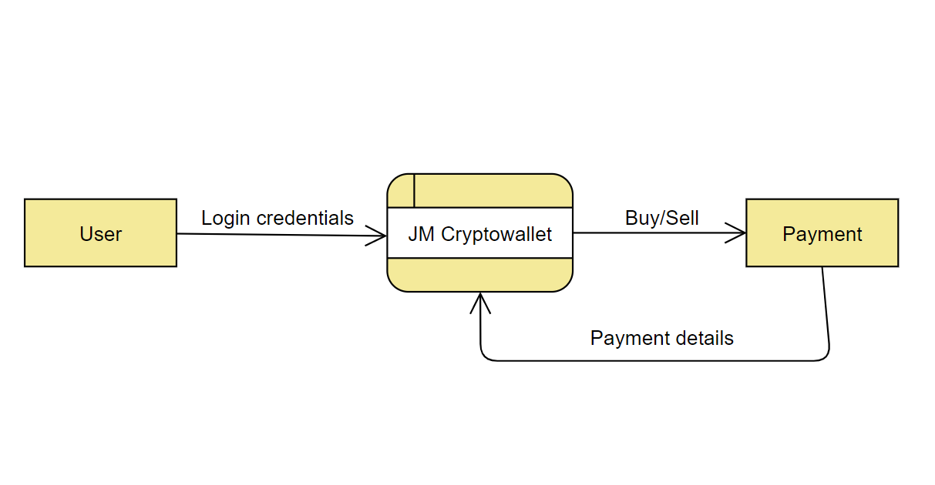
Data flow diagram – Level 0

Slide 9
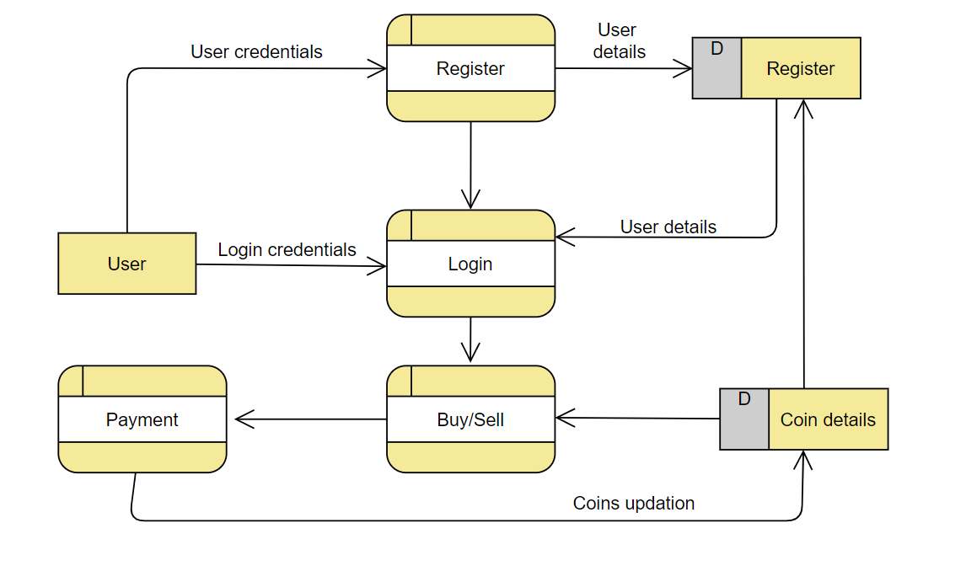
Data flow diagram – Level 1

Slide 10
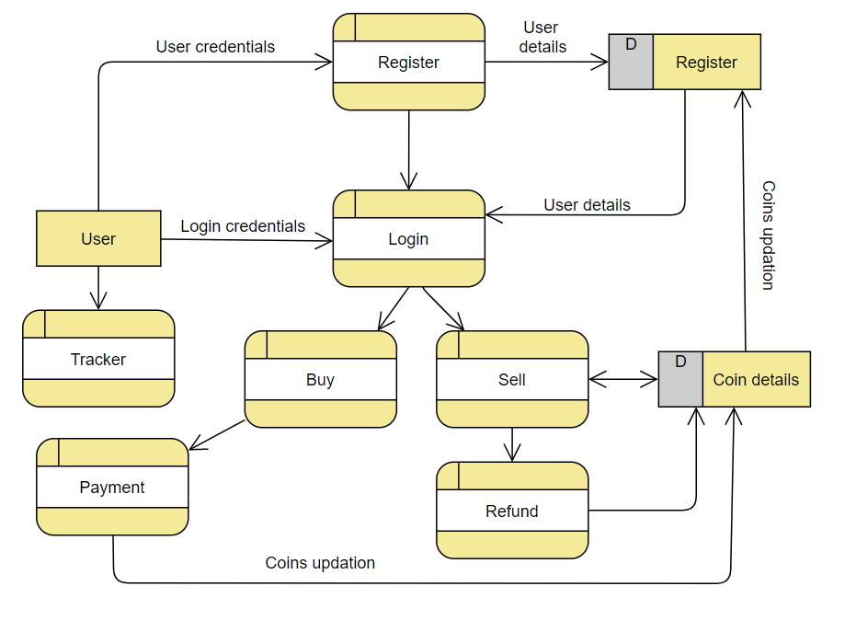
Data flow diagram – Level 2

Slide 11
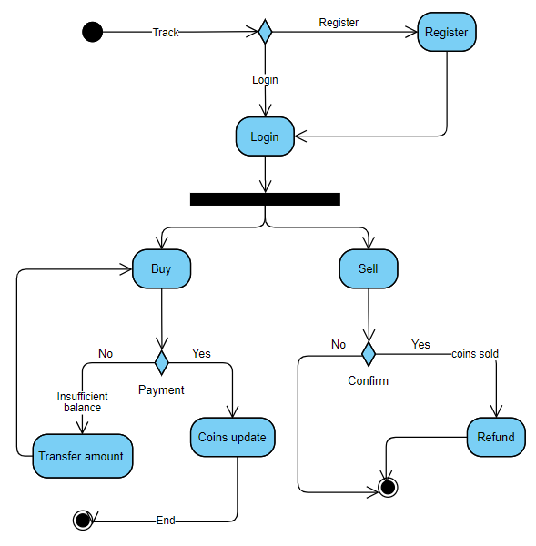
Activity diagram

Slide 12
THANK YOU

